Slide 2
COMP1206 - Programming 2
Lecture: Beyond Unit Testing
Dr Jian Shi
Jian.Shi@soton.ac.uk

Slide 3
Topics
Driver
Mock Behaviours
Integration Testing

Slide 4

Recall – Stub & Mock
Mocking isn’t all that easy though. Anti-patterns exist:
Exposes calls to static methods
Class under test creates an instance of an external class itself
Stub class
A stub is a controllable replacement for an external dependency.
Code to test:
Class A
External:
Class B
Proxy calls
Stub Class:
Class B’
Mock Object:
Mock B’

Slide 5
Stub VS. Mock
Stub
A Stub is an object that simulates real objects with the minimum number of methods required for a test.
mostly created by developers and there method is implemented in predetermined way
Mock
Mock objects are simulated objects that mimic the behaviour of real objects in controlled ways.
Usually created by open source library and mock framework like
How they used?
Stub object is usually used for state verification
Mock object is mostly used for behaviour verification

Slide 6
Driver
A driver is something like a “main program” that accepts test case data, passes such data to the component to be tested, and prints relevant results.
Drivers are used by software testers to fulfil the requirements of missing or incomplete components and modules.
Not ready
Driver
Reservation
Reservation
To be tested
Money
Seat

Slide 7
Driver
A driver is something like a “main program” that accepts test case data, passes such data to the component to be tested, and prints relevant results.
Drivers are used by software testers to fulfil the requirements of missing or incomplete components and modules.
To be tested
Reservation
Not ready
Stub
Money
Money
Seat
Stub
Seat

Slide 8
Mock Behaviours
Log
File
Class Service
String process(Task t)
client
return response
boolean write(String s)

Slide 9
Mock Behaviours
What should be specified for each mock object?
the expected sequence of incoming method calls
the return values of each of those method calls
any possible callbacks to the unit under test as a response to a method call
whether this is a strict sequence of calls or whether other calls are allowed
etc ...
Tool support to write test drivers are needed.

Slide 10
EasyMock
EasyMock is an open source software tool that provides support for generating Mock Objects for use in testing Java programs.
The basic idea is that in your unit tests, where a mock object is required, rather than explicity creating Stub classes and instances of Stub classes as mocks, the EasyMock framework will do that for you as the test executes.
The mock objects can then be injected in to your unit under test (cf. injection techniques) and used to execute your specified test cases. As part of test case execution, the mock objects can be configured to verify interactions between the unit under test and the mock object.
EasyMock works in conjunction with JUnit so that JUnit AssertionError exceptions are thrown when tests fail due to invalid interactions with a mock object.
Similar tools include - JMock, Mockito, JMockit, PowerMock.

Slide 11

Creating Mocks
createMock for the interface to simulate
record the expected behaviour
switch the Mock Object to replay state
verify expected behaviours

Slide 12
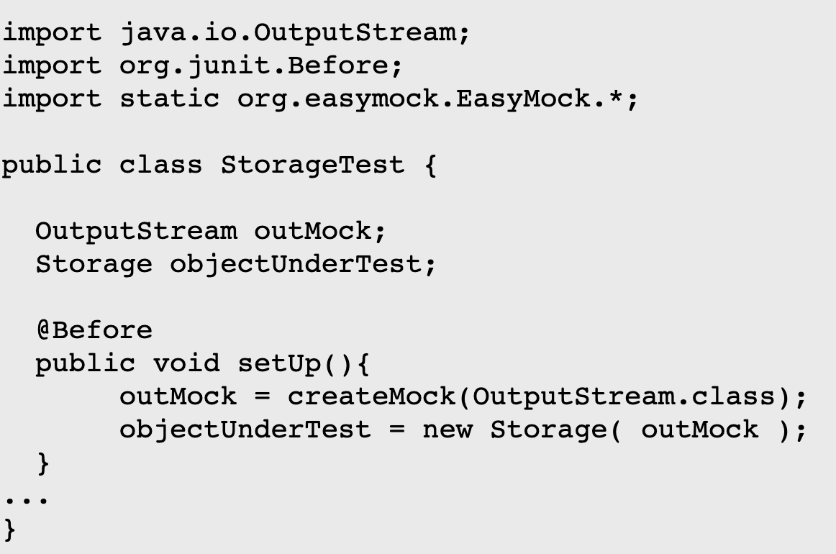
Example

Slide 13
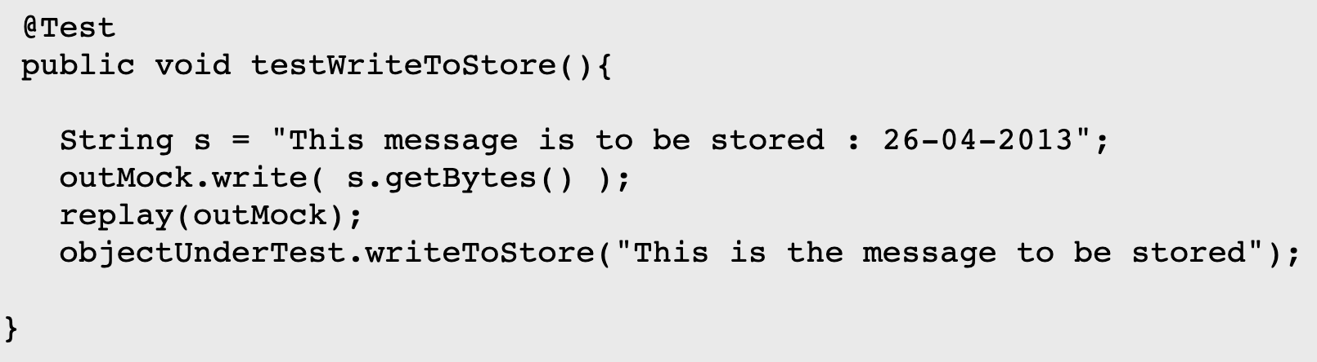
Specifying Behaviour in Mock Objects
In order to tell a Mock Object to expect certain behaviours EasyMock initially creates the Mock objects in what is known as record mode.
Once you have finished "recording" the behaviour you can switch the mock in to replay mode to let it execute.
In order to check for the absence of an expected interaction on a mock we simply use verify(mock) on the mock object.

Slide 14
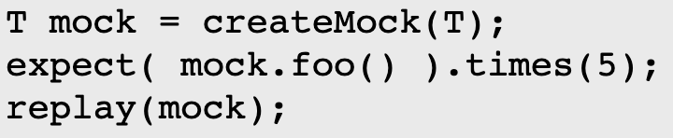
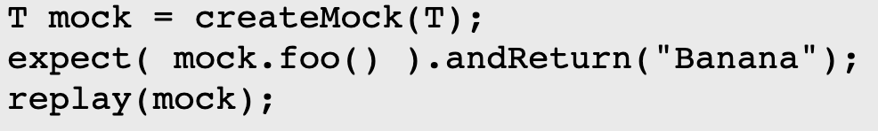
Recording More Complicated Behaviours – expect( )
Invoke for multi-times
Specify return values

Slide 15
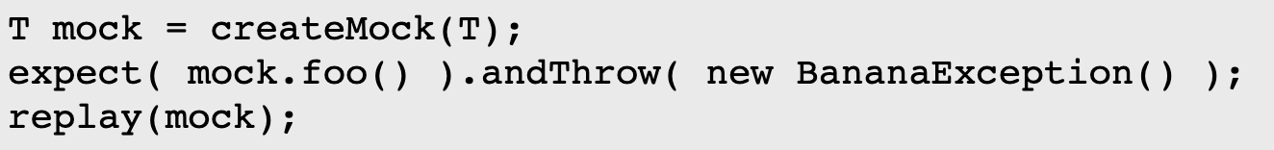
Recording More Complicated Behaviours – expect( )
Responding with an Exception
Chained response values
More features are available in EasyMock Documentation

Slide 16
Integration Testing
Recall – What is Integration Testing?
Repeatedly testing the combination of larger and larger collections of code units
What is Integration Testing different from unit testing?
You are validating behaviours of systems that are more complete than a single unit
You need to choose which and how many units to combine
The testing is often, but not exclusively, done as "Black Box" testing
This testing is typically done at a later phase in development
More emphasis on interactions on the mock objects
JUnit + EasyMock

Slide 17

Strategies for Integration Testing
Top Down Integration
Bottom Up Integration
Sandwich Integration
Big Bang Integration

Slide 18
Top Down Integration
This is an incremental strategy.
Test the high-level modules in isolation (stub dependencies)
Add in the modules that the module in step 1 calls and test them together (stub lower dependencies)
Repeat step 2 until you have reached the lowest level modules.
To be tested
Log-in
User database
Stub
User database
Sign-up
Stub
Sign-up

Slide 19
Top Down Integration
Advantages:
Because the entry point to the test is likely to be an entry point to the application, the drivers are easy to write
You can localise faults easily due to the incremental nature of the tests.
Early prototype of application is encouraged
Major design flaws show up early
Disadvantages:
Lots of stubs and mock objects are required from step 1
Modules lowest in the hierarchy tested in context rather than in isolation. May not be sufficient if they are reused.

Slide 20
Bottom Up Integration
This is also an incremental strategy.
Test the low-level modules in isolation (there shouldn't be any stubbed dependencies)
Add in the modules that call the module in step 1 and test them together (again, no stubs)
Repeat step 2 until you have reached the highest level modules.
Log-in
Driver
Log-in
Driver
User database
User database
To be tested
Sign-up

Slide 21
Bottom Up Integration
Advantages:
You can localise faults easily due to the incremental nature of the tests.
No, or few stubs!
Reusable low-level modules tested thoroughly
Testing in parallel with development
Major design flaws show up early
Disadvantages:
Needs drivers - entry points to the modules not always clear
Logic of the overall solution only tested late in the process

Slide 22
Sandwich and Big Bang Integration
Sandwich Integration is a hybrid of the previous two: identify three layers of the system, top, middle and bottom, and test the top using a top down strategy, test the bottom using a bottom up strategy and include the middle after doing this.
This is somewhat more complicated as an approach but can gain some of the benefits of and mitigate the problems of both.
Big Bang Integration refers to a non-incremental strategy in which each unit is tested thoroughly in isolation and then the whole system is integrated.
This is a common approach as it can be less time-consuming than the others and is suitable for smaller systems.
The disadvantages should be clear - unit testing every unit means lots of drivers and stubs, it doesn't match with the development strategy, fault localisation is tricky and it is easy to miss interface faults.

Slide 23
Summary
Unit testing should not just be about straight input/output behaviour.
All interactions across the seam should be specified and validated.
Mock objects can be generated and specified using tool support. The examples below show a use of EasyMock.
Integration testing is similar to Unit testing as an activity but requires a strategy.

Slide 24
Thanks for watching!

